Slide 1
Experimenting with Text Classification Algorithms in News Articles: SVM vs. Naive Bayesian Algorithm
Nuhi BESIMI, Adrian BESIMI, Visar SHEHU

Slide 2
Content
Collected Data
Data Pre-processing
The Naïve Bayes Classifier
SVM (Support Vector Machine)
Experiment and Evaluation
Accuracy
Execution Time
Future work

Slide 3
Collected Data
Sources:
CNET – http://cnet.com
PCWorld – http://pcworld.com
TechCrunch – http://techcrunch.com
NyTimes – http://nytimes.com
Goal – http://goal.com
Categories
Politics
Technology
Sports

Slide 4
Collected Data (summary)
 | Politics News Articles | Technology News Articles | Sports News Articles | Total
Training Data | 200 (80 %) | 345 (80 %) | 409 (80 %) | 954
Testing Data | 49 (20 %) | 86 (20 %) | 102 (20 %) | 237
Total | 249 | 431 | 511 | 1191
 | CNET | PCWorld | TechCrunch | NyTimes | Goal
Number of collected documents (news articles) | 81 | 229 | 121 | 570 | 190

Slide 5
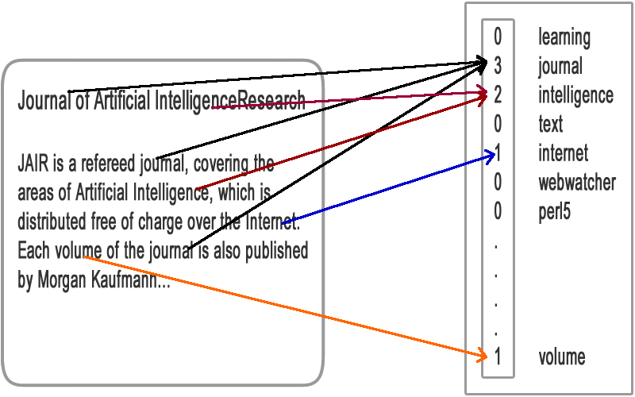
Data Pre-processing
Data Cleaning:
Stop-word removal
Stemming (Porter Algorithm)
Low term frequency filtering (count < 3)
Data Transformation:
Bag of words model (vector representation)

Slide 6
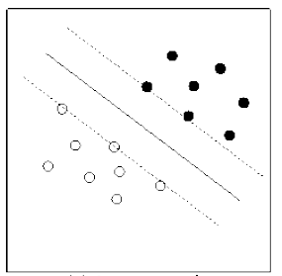
Classification Techniques
Eager Learners
Naïve Bayes Classifier
SVM (Support Vector Machine)

Slide 7
Classification Techniques
Experiment and Evaluation
Testing the accuracy of the classifiers (Total news articles: 237)
Algorithm | Naïve Bayes | SVM
Correctly classified documents | 217 | 178
Accuracy in % | 91.5 % | 75.1 %

Slide 8
Classification Techniques (2)
Algorithm | Naïve Bayes | SVM
Correctly classified documents | 43 | 29
Accuracy in % | 87.7 % | 59.1 %
Experiment and Evaluation
Politics news articles (Total news articles: 49)
Technology news articles (Total news articles: 86)
Sports news articles (Total news articles: 102)
Algorithm | Naïve Bayes | SVM
Correctly classified documents | 72 | 86
Accuracy in % | 83.7 % | 100.0 %
Algorithm | Naïve Bayes | SVM
Correctly classified documents | 102 | 70
Accuracy in % | 100.0 % | 68.6 %

Slide 9
Experiment and Evaluation
Testing SVM only two classes? (good in some cases)
Execution time (in seconds)
 | Politics & Technology | Politics & Sports | Technology & Sports
Number of documents | 135 | 151 | 188
Correctly classified documents | 120 | 130 | 149
Accuracy in % | 88.8 % | 87.0 % | 79.2 %
Algorithm | Naïve Bayes | SVM
Training phase (in seconds) | 612 | 7
Testing phase (single text document) | 1.5 | <0.1

Slide 10
Conclusion: the findings
SVM (Support Vector Machine)
Definitely the fastest classifier and faster training (100x faster training than Naïve Bayesian classifier)
Works very good in large datasets
Works better in two class problems
Naïve Bayes Classifier
Very accurate when the number of training instances is high enough
Slower comparing to SVM
Larger dataset… bigger problems

Slide 11
Future Work
News Archive (way back machine?)
Crawl & store news from various media in Macedonia
Store the changes in the text (find the text differences) for a given time interval
Get the content, not just RSS
Create Screen shots
Measure similarity (plagiarism) between news sources (cosine similarity)
Visualize trends in news
Use to verify the facts (Media Fact Checking Service in Macedonia)
Financially supported by Metamorphosis Foundation & USAID (maybe)

Slide 12
THANK YOU
Questions?
Experimenting with Text Classification Algorithms in News Articles: SVM vs. Naive Bayesian Algorithm
Nuhi BESIMI, Adrian BESIMI, Visar SHEHU

